Slide 1
Principal Components Analysis and Reliability
Prof. Andy Field

Slide 2
Aims
What Are factors?
Representing factors
  Graphs and equations
Extracting factors
  Methods and criteria
Interpreting factor structures
  Factor rotation
Reliability
  Cronbach’s alpha

Slide 3
When and Why?
To test for clusters of variables or measures
To see whether different measures are tapping aspects of a common dimension
  E.g. anal-retentiveness, number of friends, and social skills might be aspects of the common dimension of ‘statistical ability’

Slide 4
R-Matrix
In factor analysis we look to reduce the R-matrix into smaller set of uncorrelated dimensions.

Slide 5
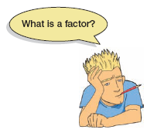
What is a Factor?
If several variables correlate highly, they might measure aspects of a common underlying dimension.
  These dimensions are called factors.
Factors are classification axis along which the measures can be plotted.
  The greater the loading of variables on a factor, the more that factor explains relationships between those variables.

Slide 6
Graphical Representation

Slide 7
Mathematical Representation

Slide 8
Factor Loadings
The b-values in the equation represent the weights of a variable on a factor.
These values are the same as the coordinates on a factor plot.
They are called factor loadings.
These values are stored in a factor pattern matrix (A).

Slide 9

The R anxiety questionnaire (RAQ)

Slide 10
Initial Considerations
The quality of analysis depends upon the quality of the data (GI⇒GO).
Test variables should correlate quite well
  r > .3.
Avoid multicollinearity:
  several variables highly correlated, r > .80.
Avoid singularity:
  some variables perfectly correlated, r = 1.
Screen the correlation matrix, eliminate any variables that obviously cause concern.

Slide 11
Further Considerations
Determinant:
  indicator of multicollinearity
  should be greater than 0.00001
Kaiser–Meyer–Olkin (KMO):
  measures sampling adequacy
  should be greater than .5
Bartlett’s test of sphericity:
  yests whether the R-matrix is an identity matrix
  should be significant at p < .05
Anti-image matrix:
  measures of sampling adequacy on diagonal,
  off-diagonal elements should be small
Reproduced:
  correlation matrix after rotation
  most residuals should be < |0.05|

Slide 12
Finding Factors: Communality
Common variance:
  Variance that a variable shares with other variables.
Unique variance:
  Variance that is unique to a particular variable.
The proportion of common variance in a variable is called the communality.
  communality = 1, all variance shared.
  communality = 0, no variance shared.
  0 < communality < 1 = some variance shared.

Slide 13
Communality = 1
Variance of
Variable 3
Variance of
Variable 1
Variance of
Variable 2
Communality = 0
Variance of
Variable 4

Slide 14
Finding Factors
We find factors by calculating the amount of common variance
  Circularity
Principal components analysis:
  Assume all variance is shared
  All communalities = 1
Factor analysis
  Estimate communality
  Use squared multiple correlation (SMC)

Slide 15
    Initial Preparation and Analysis
We want to include all of the variables in our data set in our factor analysis. We can calculate the correlation matrix:
  raqMatrix<-cor(raqData)
  round(raqMatrix, 2)

Slide 16
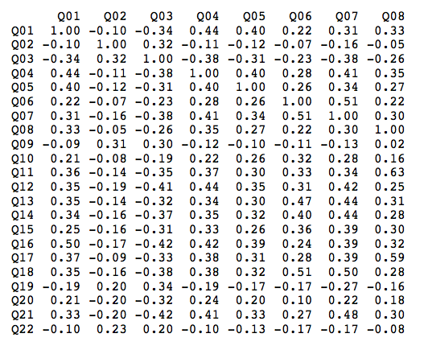
The R-matrix (or correlation matrix)

Slide 17

Factor Extraction
Kaiser’s criterion
  Kaiser (1960): retain factors with eigenvalues > 1.
Scree plot
  Cattell (1966): use ‘point of inflexion’ of the scree plot.
Which rule?
  Use Kaiser’s criterion when
    less than 30 variables, communalities after extraction > .7.
    sample size > 250 and mean communality ≥ .6.
  Scree plot is good if sample size is > 200.

Slide 18
Factor extraction using R
By extracting as many factors as there are variables we can inspect their eigenvalues and make decisions about which factors to extract. To create this model we execute one of these commands:
  pc1 <- principal(raqData, nfactors = 23, rotate = "none")
  pc1
  pc1 <- principal(raqMatrix, nfactors = 23, rotate = "none")
  pc1

Slide 19
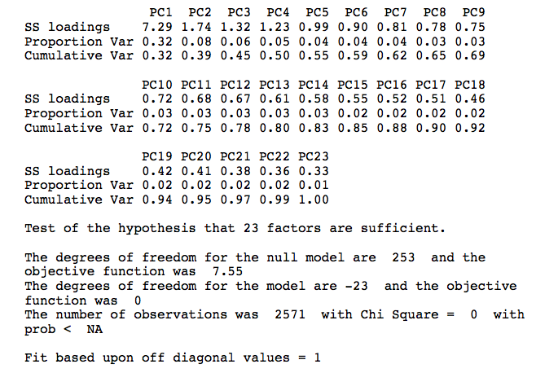
Principal Components Model

Slide 20
Examples of scree plots for data that probably have two underlying factors

Slide 21
The Scree Plot for the RAQ Data
Scree plot from principal components analysis of RAQ data. The second plot shows the point of inflexion at the fourth component.

Slide 22
Principal Components Model
Now that we know how many components we want to extract, we can rerun the analysis, specifying that number:
  pc2 <- principal(raqData, nfactors = 4, rotate = "none")
  pc2 <- principal(raqMatrix, nfactors = 4, rotate = "none")

Slide 23
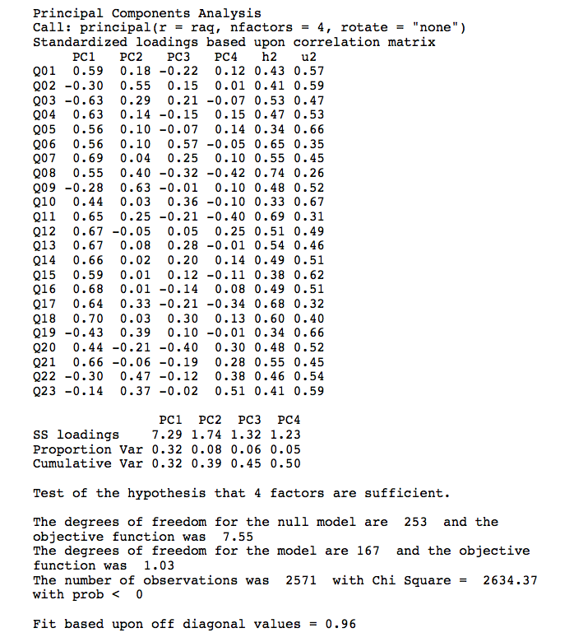

Slide 24
Residuals
Check the residuals and make sure that fewer than 50% have absolute values greater than 0.05, and that the model fit is greater than 0.90.
Execute the function below:
  residual.stats<-function(matrix){
  residuals<-as.matrix(matrix[upper.tri(matrix)])
  large.resid<-abs(residuals) > 0.05
  numberLargeResids<-sum(large.resid)
  propLargeResid<-numberLargeResids/nrow(residuals)
  rmsr<-sqrt(mean(residuals^2))
  cat("Root means squared residual = ", rmsr, "\n")
  cat("Number of absolute residuals > 0.05 = ", numberLargeResids, "\n")
  cat("Proportion of absolute residuals > 0.05 = ", propLargeResid, "\n")
  hist(residuals)
  }

Slide 25
Residuals
Having executed the function, we could use it on our residual matrix:
  resids <- factor.residuals(raqMatrix, pc2$loadings)
  residual.stats(resids)
or:
  residual.stats(factor.residuals(raqMatrix, pc2$loadings))

Slide 26

Residuals

Slide 27

Rotation
To aid interpretation it is possible to maximize the loading of a variable on one factor while minimizing its loading on all other factors
This is known as factor rotation.
There are two types:
  orthogonal (factors are uncorrelated)
  oblique (factors intercorrelate).

Slide 28
Orthogonal
Oblique

Slide 29
Orthogonal Rotation (Varimax)
To carry out a varimax rotation, we change the rotate option in the principal() function from “none” to “varimax” (we could also exclude it altogether because varimax is the default if the option is not specified):
  pc3 <- principal(raqData, nfactors = 4, rotate = "varimax")
  pc3 <- principal(raqMatrix, nfactors = 4, rotate = "varimax")

Slide 30
Orthogonal Rotation (Varimax)
Interpreting the factor loading matrix is a little complex; we can make it easier by using the print.psych() function.
Generally you should be very careful with the cut-off value – if you think that a loading of .4 will be interesting, you should use a lower cut-off (say, .3), because you don’t want to miss a loading that was .39:
  print.psych(pc3, cut = 0.3, sort = TRUE)

Slide 31
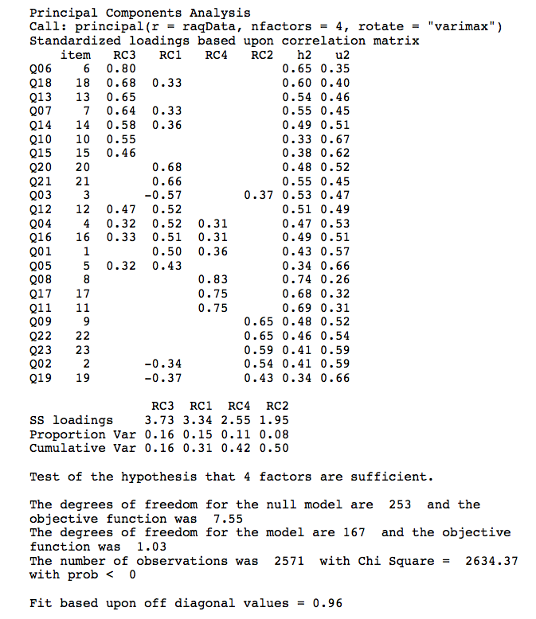
Orthogonal Rotation (Varimax)

Slide 32
Oblique Rotation
The command for an oblique rotation is very similar to that for an orthogonal rotation – we just change the rotate option from “varimax” to “oblimin”.
  pc4 <- principal(raqData, nfactors = 4, rotate = "oblimin")
  pc4 <- principal(raqMatrix, nfactors = 4, rotate = "oblimin")
As with the previous model, we can look at the factor loadings from this model in a nice easy-to-digest format by executing:
  print.psych(pc4, cut = 0.3, sort = TRUE)

Slide 33
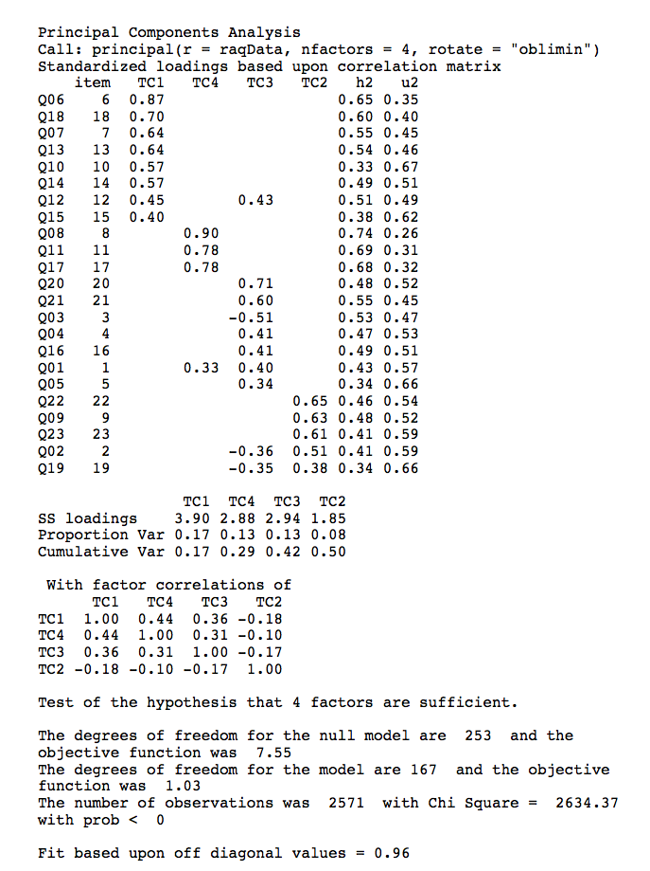
Oblique Rotation

Slide 34
Important!
We assume that algebraic factors represent psychological constructs.
The nature of these psychological dimensions is ‘guessed at’ by looking at the loadings for a factor.
This assumption is controvertible.
Many argue that factors are statistical truths only – and psychological fictions.

Slide 35
Reliability
Test–retest method
  What about practice effects/mood states?
Alternate form method
  Expensive and impractical.
Split-half method
  Splits the questionnaire into two random halves, calculates scores and correlates them.
Cronbach’s alpha
  Splits the questionnaire into all possible halves, calculates the scores, correlates them and averages the correlation for all splits (well, sort of …).
  Ranges from 0 (no reliability) to 1 (complete reliability)

Slide 36
Cronbach’s Alpha

Slide 37

Interpreting Cronbach’s Alpha
Kline (1999)
  Reliable if α > .7
Depends on the number of items
  More questions = bigger α
Treat subscales separately
Remember to reverse score reverse phrased items!
  If not, α is reduced and can even be negative

Slide 38
Reliability Analysis Using R
  Subscale 1 (Fear of computers): items 6, 7, 10, 13, 14, 15, 18
  Subscale 2 (Fear of statistics): items 1, 3, 4, 5, 12, 16, 20, 21
  Subscale 3 (Fear of mathematics): items 8, 11, 17
  Subscale 4 (Peer evaluation): items 2, 9, 19, 22, 23
Don’t forget that question 3 has a negative sign, we’ll need to remember to deal with that.
First, we’ll create four new data sets, containing the subscales for the items:
  computerFear<-raqData[, c(6, 7, 10, 13, 14, 15, 18)]
  statisticsFear <- raqData[, c(1, 3, 4, 5, 12, 16, 20, 21)]
  mathFear <- raqData[, c(8, 11, 17)]
  peerEvaluation <- raqData[, c(2, 9, 19, 22, 23)]

Slide 39
Reliability Analysis Using R
To use the alpha() function we simply input the name of the dataframe for each subscale, and, where necessary, include the keys option:
  alpha(computerFear)
  alpha(statisticsFear, keys = c(1, -1, 1, 1, 1, 1, 1, 1))
  alpha(mathFear)
  alpha(peerEvaluation)

Slide 40
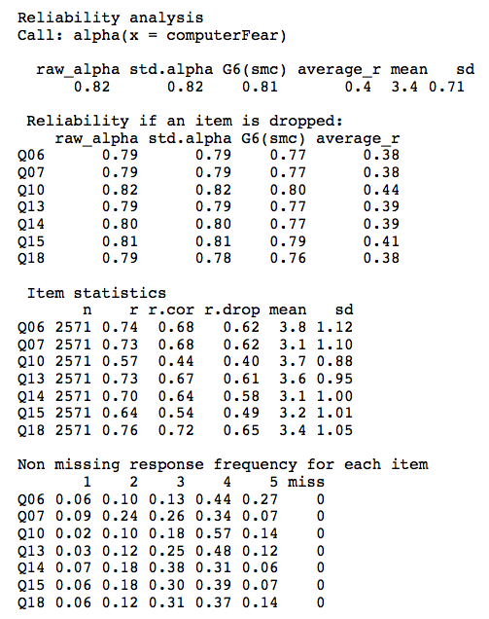

Slide 41
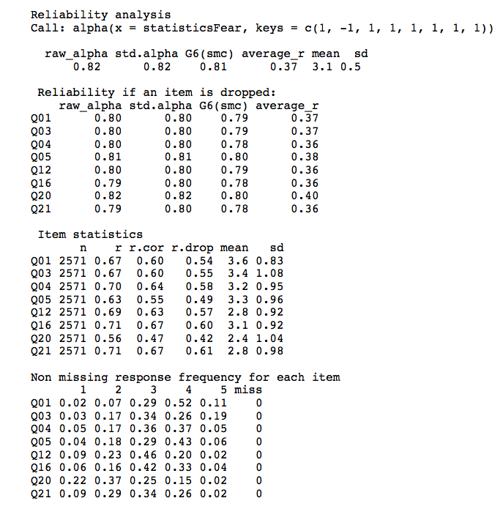

Slide 42
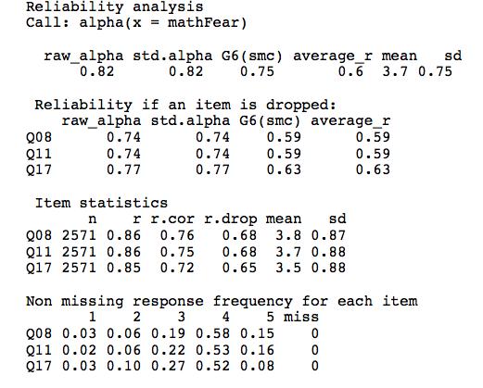

Slide 43
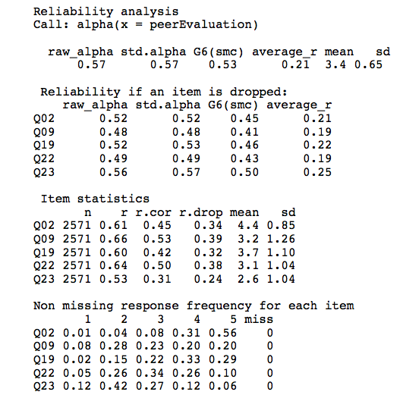

Slide 44
The End?
Describe factor structure/reliability
What items should be retained?
  What items did you eliminate and why?
Application
  Where will your questionnaire be used?
  How does it fit in with psychological theory?

